Slide 1
Product Images For Catalogue Communications (Stay Connected Theme)

Slide 2
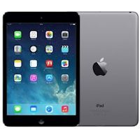
PID - 17963 APPLE IPAD MINI WI FI 32GB SPACE GRAY

Slide 3
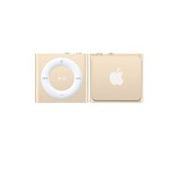
PID – 31755 Apple ipod Shuffle 2Gb Gold

Slide 4
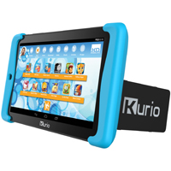
PID – 36910 Kurio Tab 2 7" Tablet 8GB Android 5.0 Quadcore WiFi

Slide 5
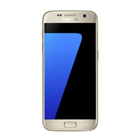
PID – 48312 Sim Free Samsung Galaxy S7 - Gold

Slide 6
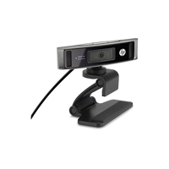
PID – 14988 HP HD 4310 Webcam Europe

Slide 7
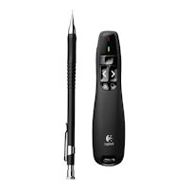
PID – 17881 Logitech Wireless Presenter

Slide 8
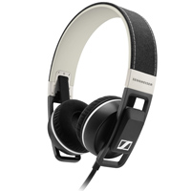
PID – 27490 Sennheiser Urbanite G Black Headphones for Samsung Galaxy

Slide 9
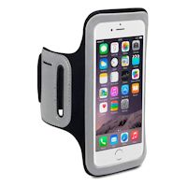
PID – 30030 Shocksock Armband iPhone 6 Case 4.7 Black

Slide 10
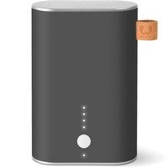
PID – 38992 Fresh 'N Rebel Powerbank 9000 mAh Concrete Mobile Phone Charger

Slide 11
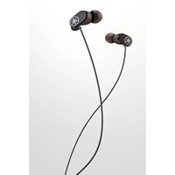
PID – 47238 Yamaha EPH-W32 Black Bluetooth Earphones

Slide 12
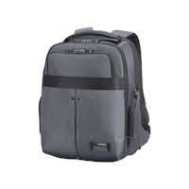
PID – 27572 Samsonite Cityvibe Laptop Backpackup to 16Inch/40Cm Ash Grey

Slide 13
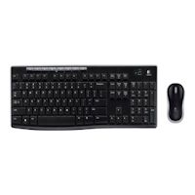
PID – 17879 Logitech Wireless Combo Keyboard & Mouse

